Slide 1
An Introduction to Parallel Programming
Peter Pacheco
Chapter 4
Shared Memory Programming with Pthreads
Copyright © 2010, Elsevier Inc. All rights Reserved
Notes:
The University of Adelaide, School of Computer Science
*
Chapter 2 — Instructions: Language of the Computer
‹#›

Slide 2
Roadmap
# Chapter Subtitle
Problems programming shared memory systems.
Controlling access to a critical section.
Thread synchronization.
Programming with POSIX threads.
Mutexes.
Producer-consumer synchronization and semaphores.
Barriers and condition variables.
Read-write locks.
Thread safety.
Copyright © 2010, Elsevier Inc. All rights Reserved
Notes:
The University of Adelaide, School of Computer Science
*
Chapter 2 — Instructions: Language of the Computer
‹#›

Slide 3
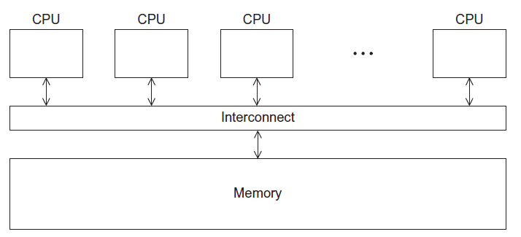
A Shared Memory System
Copyright © 2010, Elsevier Inc. All rights Reserved

Slide 4
Processes and Threads
A process is an instance of a running (or suspended) program.
Threads are analogous to a “light-weight” process.
In a shared memory program a single process may have multiple threads of control.
Copyright © 2010, Elsevier Inc. All rights Reserved

Slide 5
POSIX® Threads
Also known as Pthreads.
A standard for Unix-like operating systems.
A library that can be linked with C programs.
Specifies an application programming interface (API) for multi-threaded programming.
Copyright © 2010, Elsevier Inc. All rights Reserved

Slide 6

Caveat
The Pthreads API is only available on POSIXR systems — Linux, MacOS X, Solaris, HPUX, …
Copyright © 2010, Elsevier Inc. All rights Reserved

Slide 7
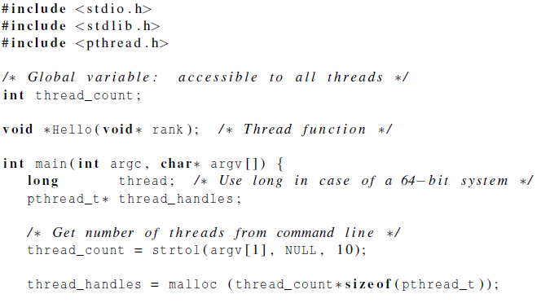
Hello World! (1)
declares the various Pthreads
functions, constants, types, etc.
Copyright © 2010, Elsevier Inc. All rights Reserved

Slide 8
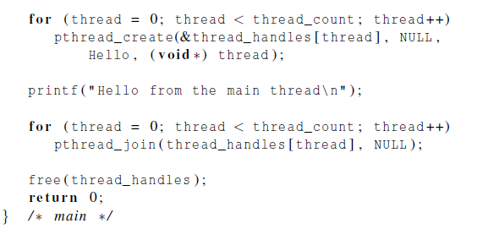
Hello World! (2)
Copyright © 2010, Elsevier Inc. All rights Reserved

Slide 9
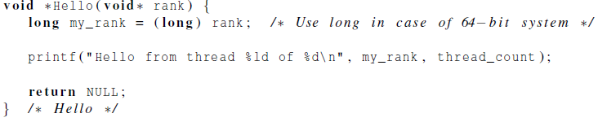
Hello World! (3)
Copyright © 2010, Elsevier Inc. All rights Reserved

Slide 10
Compiling a Pthread program
gcc −g −Wall −o pth_hello pth_hello . c −lpthread
link in the Pthreads library
Copyright © 2010, Elsevier Inc. All rights Reserved

Slide 11
Running a Pthreads program
. / pth_hello <number of threads>
. / pth_hello 1
Hello from the main thread
Hello from thread 0 of 1
. / pth_hello 4
Hello from the main thread
Hello from thread 0 of 4
Hello from thread 1 of 4
Hello from thread 2 of 4
Hello from thread 3 of 4
Copyright © 2010, Elsevier Inc. All rights Reserved

Slide 12

Global variables
Can introduce subtle and confusing bugs!
Limit use of global variables to situations in which they’re really needed.
Shared variables.
Copyright © 2010, Elsevier Inc. All rights Reserved

Slide 13
Starting the Threads
Processes in MPI are usually started by a script.
In Pthreads the threads are started by the program executable.
Copyright © 2010, Elsevier Inc. All rights Reserved

Slide 14
Starting the Threads
pthread.h
One object for each thread.
pthread_t
int pthread_create (
pthread_t* thread_p /* out */ ,
const pthread_attr_t* attr_p /* in */ ,
void* (*start_routine ) ( void ) /* in */ ,
void* arg_p /* in */ ) ;
Copyright © 2010, Elsevier Inc. All rights Reserved

Slide 15
pthread_t objects
Opaque
The actual data that they store is system-specific.
Their data members aren’t directly accessible to user code.
However, the Pthreads standard guarantees that a pthread_t object does store enough information to uniquely identify the thread with which it’s associated.
Copyright © 2010, Elsevier Inc. All rights Reserved

Slide 16
A closer look (1)
int pthread_create (
pthread_t* thread_p /* out */ ,
const pthread_attr_t* attr_p /* in */ ,
void* (*start_routine ) ( void ) /* in */ ,
void* arg_p /* in */ ) ;
We won’t be using, so we just pass NULL.
Allocate before calling.
Copyright © 2010, Elsevier Inc. All rights Reserved

Slide 17
A closer look (2)
int pthread_create (
pthread_t* thread_p /* out */ ,
const pthread_attr_t* attr_p /* in */ ,
void* (*start_routine ) ( void ) /* in */ ,
void* arg_p /* in */ ) ;
Pointer to the argument that should
be passed to the function start_routine.
The function that the thread is to run.
Copyright © 2010, Elsevier Inc. All rights Reserved

Slide 18
Function started by pthread_create
Prototype: void* thread_function ( void* args_p ) ;
Void* can be cast to any pointer type in C.
So args_p can point to a list containing one or more values needed by thread_function.
Similarly, the return value of thread_function can point to a list of one or more values.
Copyright © 2010, Elsevier Inc. All rights Reserved

Slide 19
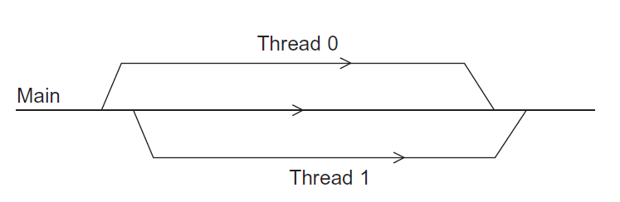
Running the Threads
Main thread forks and joins two threads.
Copyright © 2010, Elsevier Inc. All rights Reserved

Slide 20
Stopping the Threads
We call the function pthread_join once for each thread.
A single call to pthread_join will wait for the thread associated with the pthread_t object to complete.
Copyright © 2010, Elsevier Inc. All rights Reserved

Slide 21
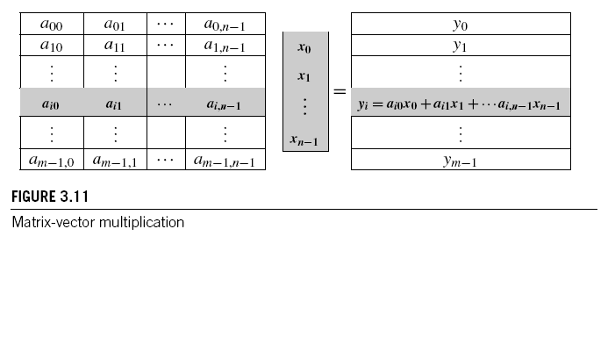
MATRIX-VECTOR MULTIPLICATION IN PTHREADS
Copyright © 2010, Elsevier Inc. All rights Reserved

Slide 22
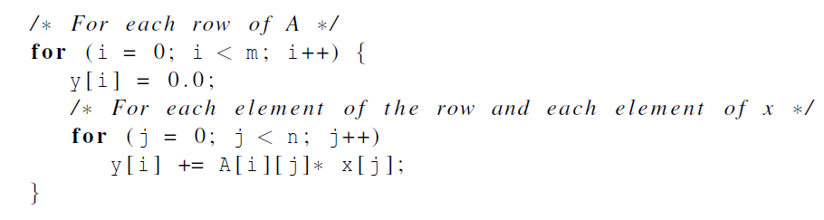
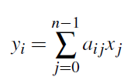
Serial pseudo-code
Copyright © 2010, Elsevier Inc. All rights Reserved

Slide 23
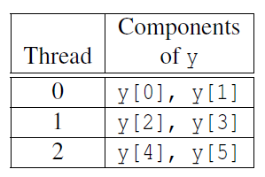
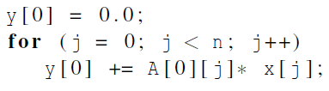
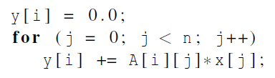
Using 3 Pthreads
thread 0
general case
Copyright © 2010, Elsevier Inc. All rights Reserved

Slide 24
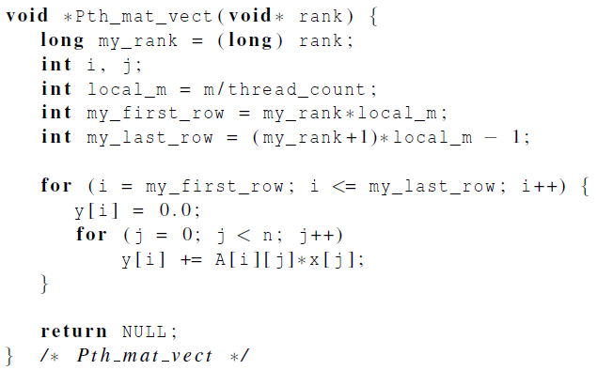
Pthreads matrix-vector multiplication
Copyright © 2010, Elsevier Inc. All rights Reserved

Slide 25
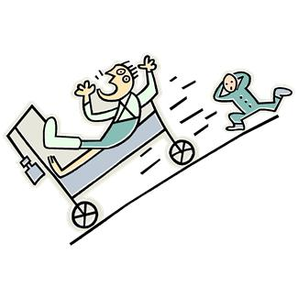
CRITICAL SECTIONS
Copyright © 2010, Elsevier Inc. All rights Reserved

Slide 26
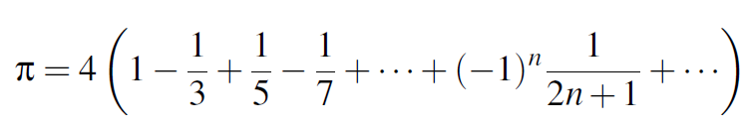
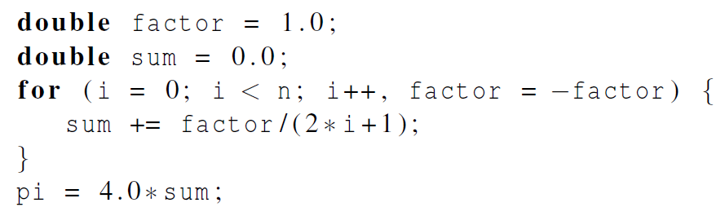
Estimating π
Copyright © 2010, Elsevier Inc. All rights Reserved

Slide 27
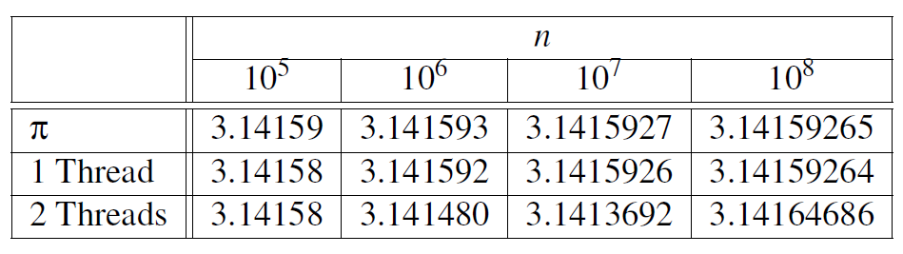
Using a dual core processor
Note that as we increase n, the estimate with one thread gets better and better.
Copyright © 2010, Elsevier Inc. All rights Reserved

Slide 28
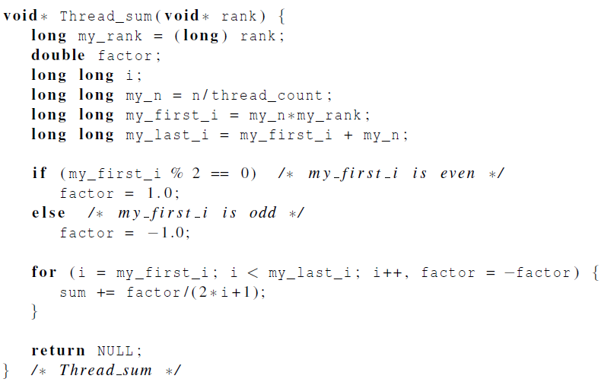
A thread function for computing π
Copyright © 2010, Elsevier Inc. All rights Reserved

Slide 29
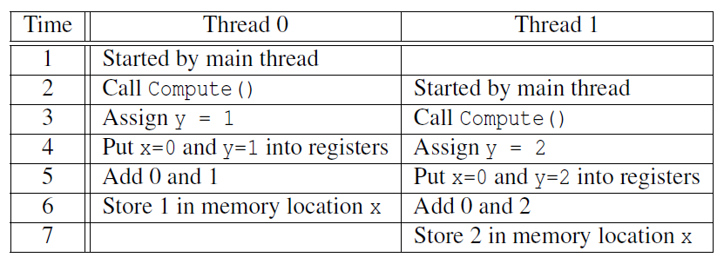

Possible race condition
Copyright © 2010, Elsevier Inc. All rights Reserved

Slide 30
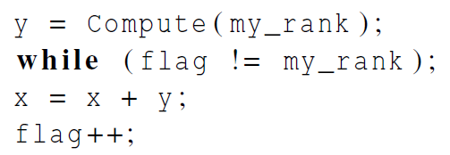
Busy-Waiting
A thread repeatedly tests a condition, but, effectively, does no useful work until the condition has the appropriate value.
Beware of optimizing compilers, though!
flag initialized to 0 by main thread
Copyright © 2010, Elsevier Inc. All rights Reserved

Slide 31
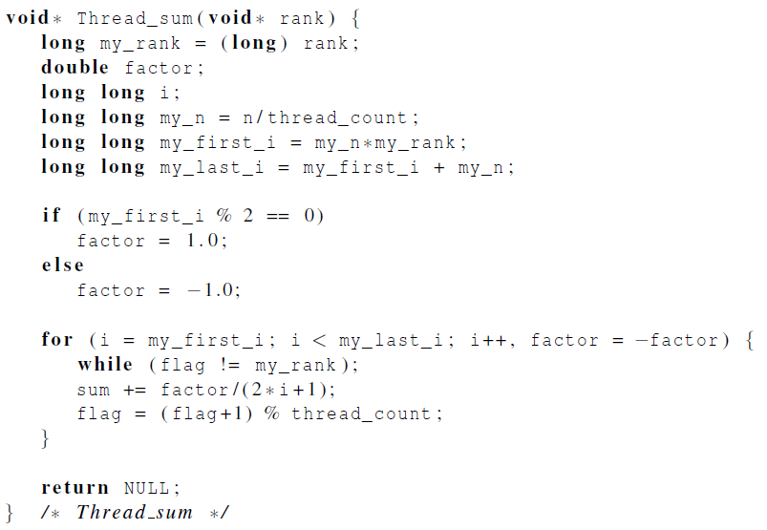
Pthreads global sum with busy-waiting
Copyright © 2010, Elsevier Inc. All rights Reserved

Slide 32
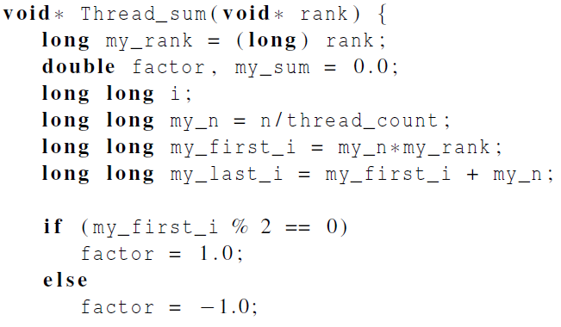
Global sum function with critical section after loop (1)
Copyright © 2010, Elsevier Inc. All rights Reserved

Slide 33
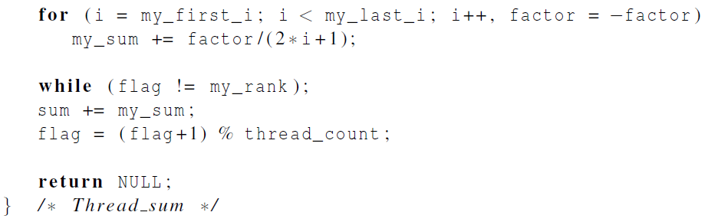
Global sum function with critical section after loop (2)
Copyright © 2010, Elsevier Inc. All rights Reserved

Slide 34
Mutexes
A thread that is busy-waiting may continually use the CPU accomplishing nothing.
Mutex (mutual exclusion) is a special type of variable that can be used to restrict access to a critical section to a single thread at a time.
Copyright © 2010, Elsevier Inc. All rights Reserved

Slide 35

Mutexes
Used to guarantee that one thread “excludes” all other threads while it executes the critical section.
The Pthreads standard includes a special type for mutexes: pthread_mutex_t.
Copyright © 2010, Elsevier Inc. All rights Reserved

Slide 36
Mutexes
When a Pthreads program finishes using a mutex, it should call
In order to gain access to a critical section a thread calls
Copyright © 2010, Elsevier Inc. All rights Reserved

Slide 37
Mutexes
When a thread is finished executing the code in a critical section, it should call
Copyright © 2010, Elsevier Inc. All rights Reserved

Slide 38
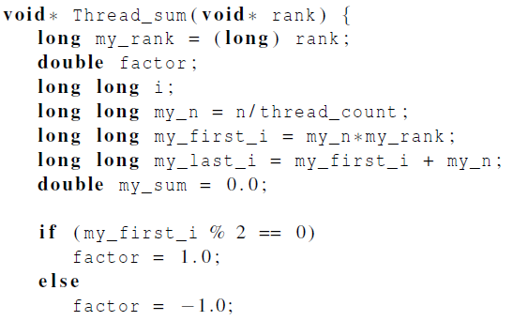
Global sum function that uses a mutex (1)
Copyright © 2010, Elsevier Inc. All rights Reserved

Slide 39
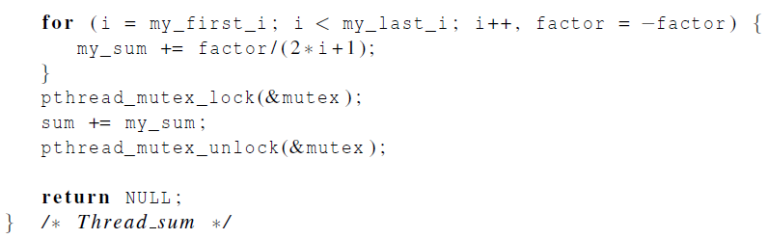
Global sum function that uses a mutex (2)
Copyright © 2010, Elsevier Inc. All rights Reserved

Slide 40
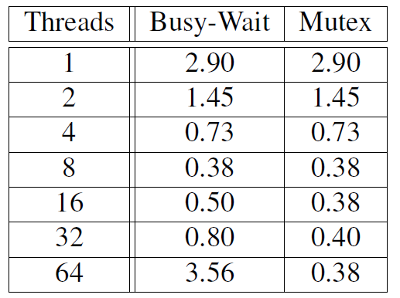
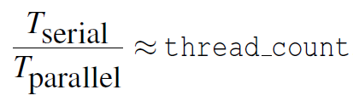
Run-times (in seconds) of π programs using n = 108 terms on a system with two four-core processors.
Copyright © 2010, Elsevier Inc. All rights Reserved

Slide 41
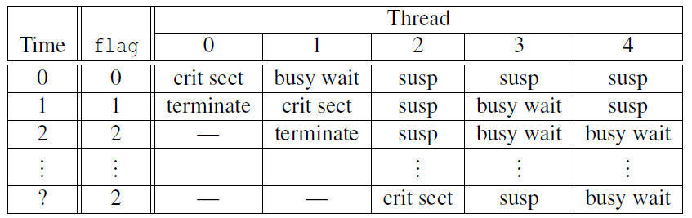
Possible sequence of events with busy-waiting and more threads than cores.
Copyright © 2010, Elsevier Inc. All rights Reserved

Slide 42
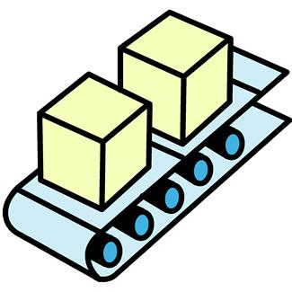
PRODUCER-CONSUMER SYNCHRONIZATION AND SEMAPHORES
Copyright © 2010, Elsevier Inc. All rights Reserved

Slide 43
Issues
Busy-waiting enforces the order threads access a critical section.
Using mutexes, the order is left to chance and the system.
There are applications where we need to control the order threads access the critical section.
Copyright © 2010, Elsevier Inc. All rights Reserved

Slide 44
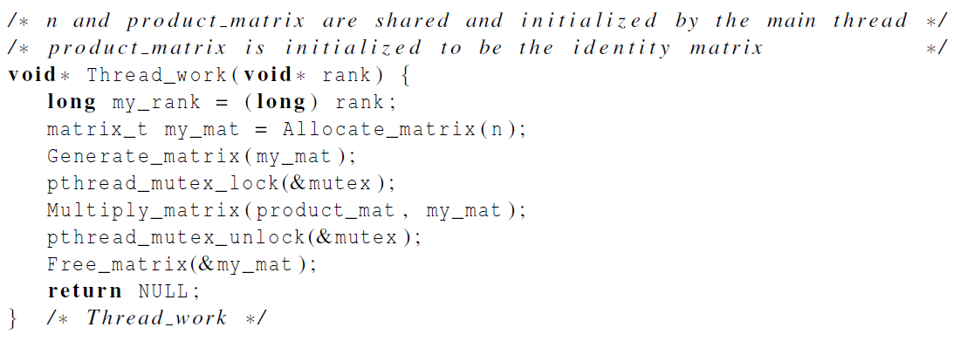
Problems with a mutex solution
Copyright © 2010, Elsevier Inc. All rights Reserved

Slide 45
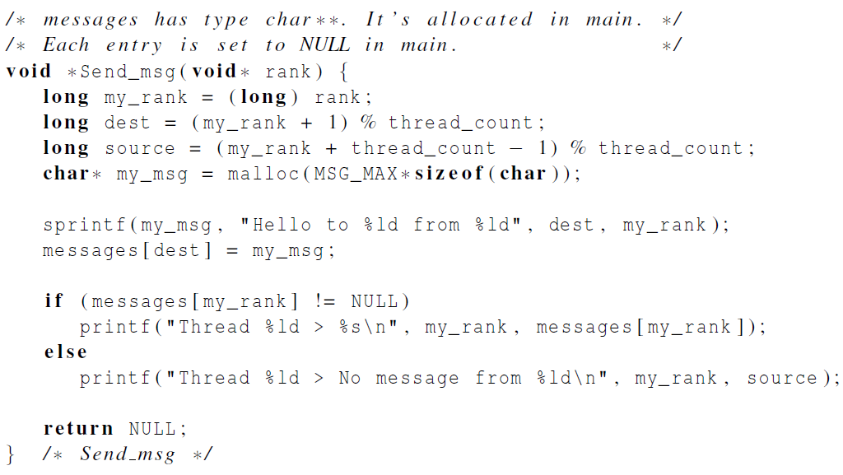
A first attempt at sending messages using pthreads
Copyright © 2010, Elsevier Inc. All rights Reserved

Slide 46

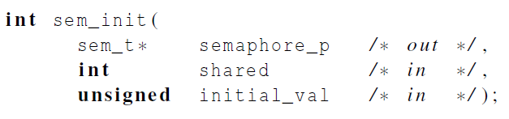
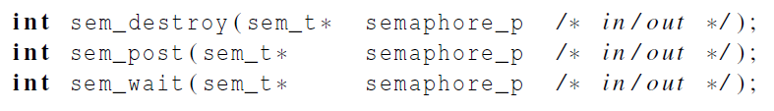
Syntax of the various semaphore functions
Semaphores are not part of Pthreads;
you need to add this.
Copyright © 2010, Elsevier Inc. All rights Reserved

Slide 47
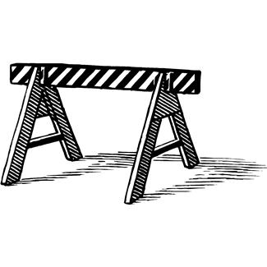
BARRIERS AND CONDITION VARIABLES
Copyright © 2010, Elsevier Inc. All rights Reserved

Slide 48
Barriers
Synchronizing the threads to make sure that they all are at the same point in a program is called a barrier.
No thread can cross the barrier until all the threads have reached it.
Copyright © 2010, Elsevier Inc. All rights Reserved

Slide 49
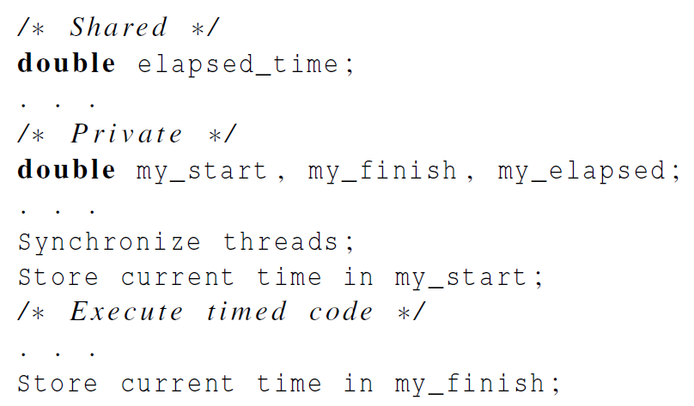
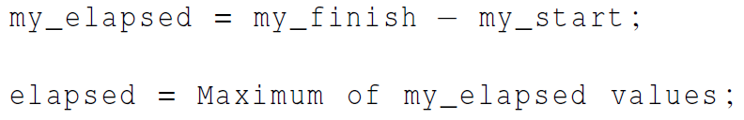
Using barriers to time the slowest thread
Copyright © 2010, Elsevier Inc. All rights Reserved

Slide 50
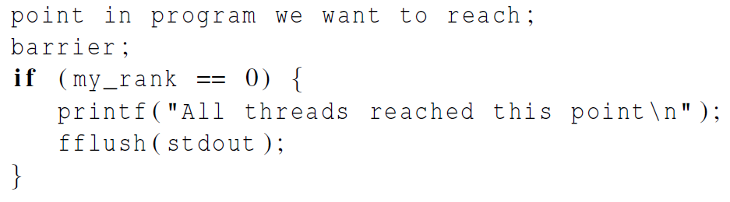

Using barriers for debugging
Copyright © 2010, Elsevier Inc. All rights Reserved

Slide 51
Busy-waiting and a Mutex
Implementing a barrier using busy-waiting and a mutex is straightforward.
We use a shared counter protected by the mutex.
When the counter indicates that every thread has entered the critical section, threads can leave the critical section.
Copyright © 2010, Elsevier Inc. All rights Reserved

Slide 52
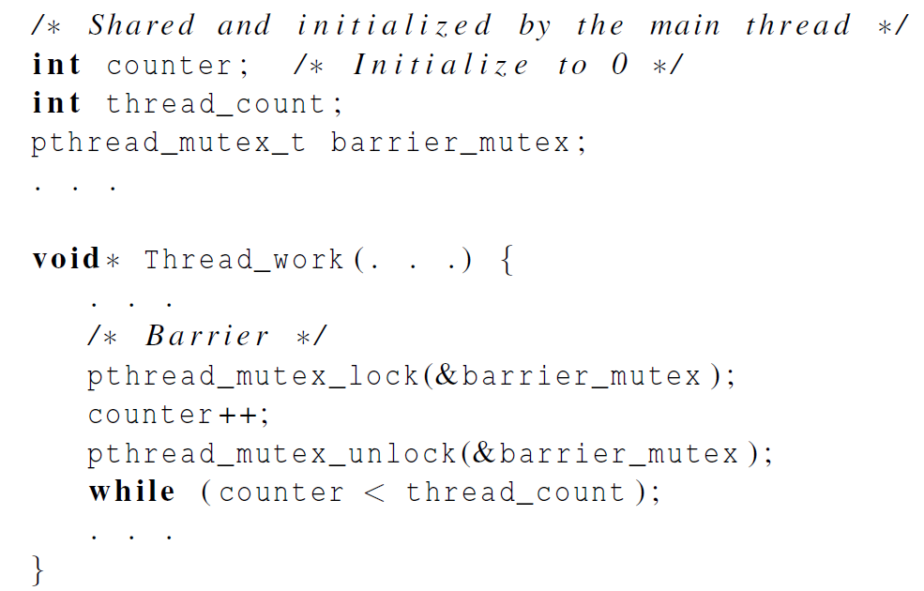
Busy-waiting and a Mutex
We need one counter
variable for each
instance of the barrier,
otherwise problems are likely to occur.
Copyright © 2010, Elsevier Inc. All rights Reserved

Slide 53
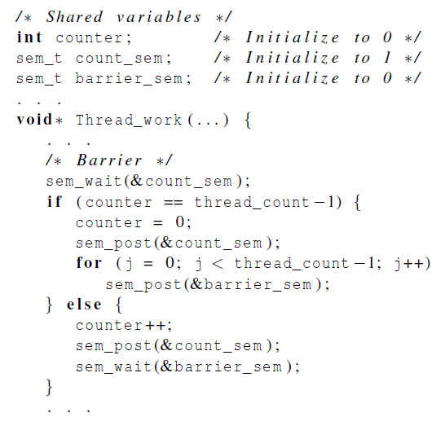
Implementing a barrier with semaphores
Copyright © 2010, Elsevier Inc. All rights Reserved

Slide 54
Condition Variables
A condition variable is a data object that allows a thread to suspend execution until a certain event or condition occurs.
When the event or condition occurs another thread can signal the thread to “wake up.”
A condition variable is always associated with a mutex.
Copyright © 2010, Elsevier Inc. All rights Reserved

Slide 55
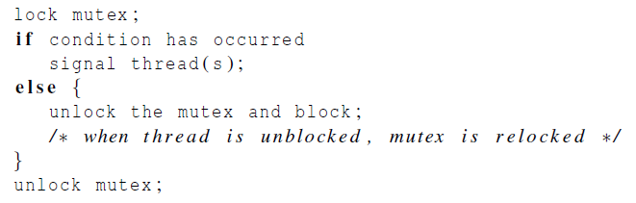
Condition Variables
Copyright © 2010, Elsevier Inc. All rights Reserved

Slide 56
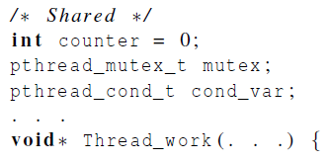
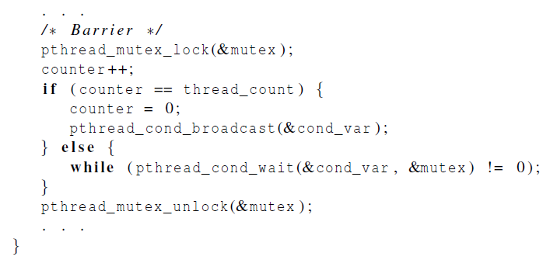
Implementing a barrier with condition variables
Copyright © 2010, Elsevier Inc. All rights Reserved

Slide 57

READ-WRITE LOCKS
Copyright © 2010, Elsevier Inc. All rights Reserved

Slide 58
Controlling access to a large, shared data structure
Let’s look at an example.
Suppose the shared data structure is a sorted linked list of ints, and the operations of interest are Member, Insert, and Delete.
Copyright © 2010, Elsevier Inc. All rights Reserved

Slide 59
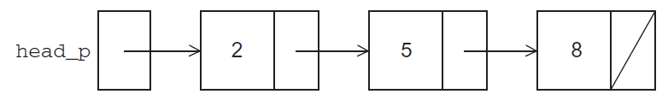
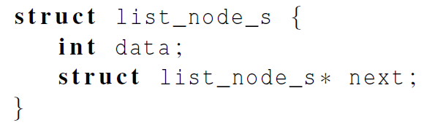
Linked Lists
Copyright © 2010, Elsevier Inc. All rights Reserved

Slide 60
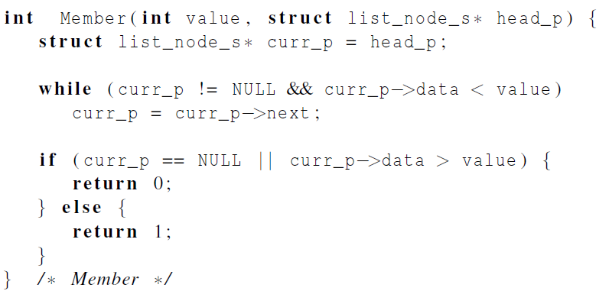
Linked List Membership
Copyright © 2010, Elsevier Inc. All rights Reserved

Slide 61
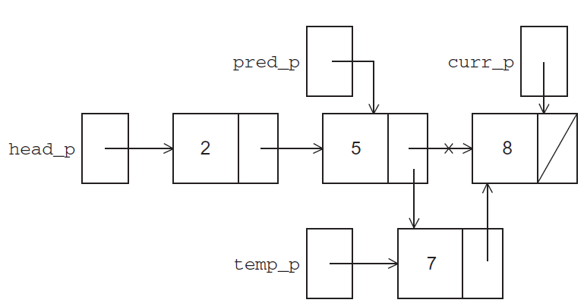
Inserting a new node into a list
Copyright © 2010, Elsevier Inc. All rights Reserved

Slide 62
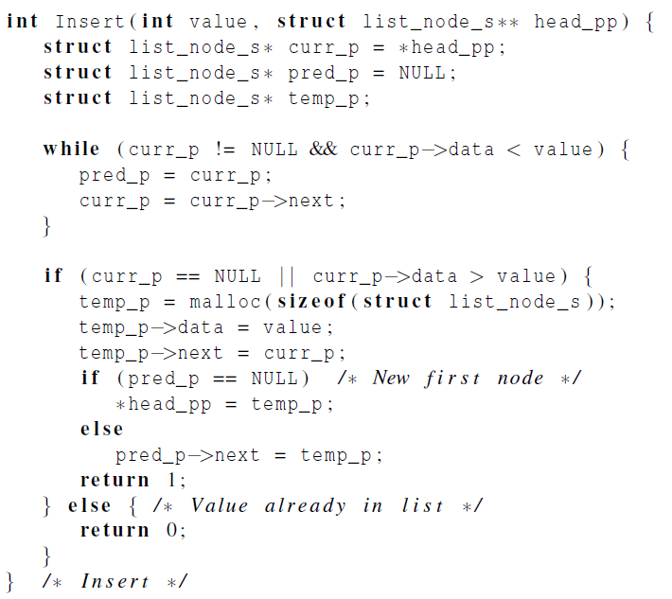
Inserting a new node into a list
Copyright © 2010, Elsevier Inc. All rights Reserved

Slide 63
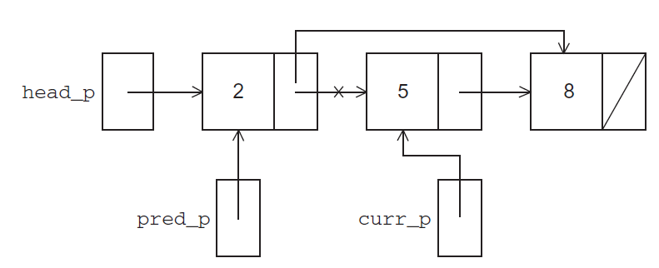
Deleting a node from a linked list
Copyright © 2010, Elsevier Inc. All rights Reserved

Slide 64
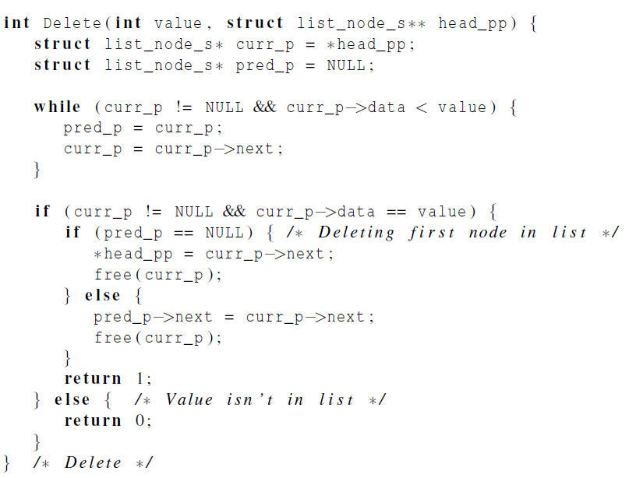
Deleting a node from a linked list
Copyright © 2010, Elsevier Inc. All rights Reserved

Slide 65
A Multi-Threaded Linked List
Let’s try to use these functions in a Pthreads program.
In order to share access to the list, we can define head_p to be a global variable.
This will simplify the function headers for Member, Insert, and Delete, since we won’t need to pass in either head_p or a pointer to head_p: we’ll only need to pass in the value of interest.
Copyright © 2010, Elsevier Inc. All rights Reserved

Slide 66
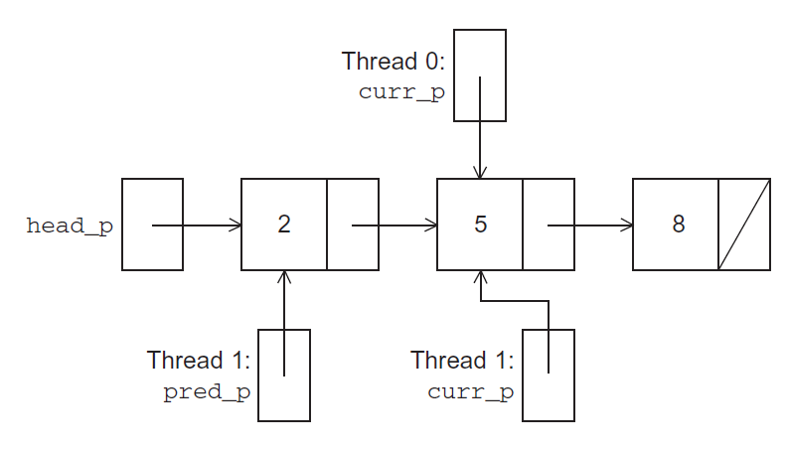
Simultaneous access by two threads
Copyright © 2010, Elsevier Inc. All rights Reserved

Slide 67
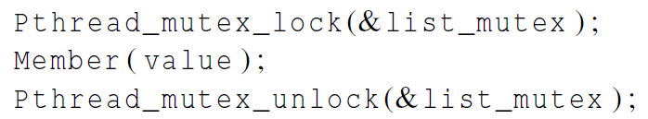
Solution #1
An obvious solution is to simply lock the list any time that a thread attempts to access it.
A call to each of the three functions can be protected by a mutex.
In place of calling Member(value).
Copyright © 2010, Elsevier Inc. All rights Reserved

Slide 68
Issues
We’re serializing access to the list.
If the vast majority of our operations are calls to Member, we’ll fail to exploit this opportunity for parallelism.
On the other hand, if most of our operations are calls to Insert and Delete, then this may be the best solution since we’ll need to serialize access to the list for most of the operations, and this solution will certainly be easy to implement.
Copyright © 2010, Elsevier Inc. All rights Reserved

Slide 69

Solution #2
Instead of locking the entire list, we could try to lock individual nodes.
A “finer-grained” approach.
Copyright © 2010, Elsevier Inc. All rights Reserved

Slide 70
Issues
This is much more complex than the original Member function.
It is also much slower, since, in general, each time a node is accessed, a mutex must be locked and unlocked.
The addition of a mutex field to each node will substantially increase the amount of storage needed for the list.
Copyright © 2010, Elsevier Inc. All rights Reserved

Slide 71

Implementation of Member with one mutex per list node (1)
Copyright © 2010, Elsevier Inc. All rights Reserved

Slide 72

Implementation of Member with one mutex per list node (2)
Copyright © 2010, Elsevier Inc. All rights Reserved

Slide 73
Pthreads Read-Write Locks
Neither of our multi-threaded linked lists exploits the potential for simultaneous access to any node by threads that are executing Member.
The first solution only allows one thread to access the entire list at any instant.
The second only allows one thread to access any given node at any instant.
Copyright © 2010, Elsevier Inc. All rights Reserved

Slide 74
Pthreads Read-Write Locks
A read-write lock is somewhat like a mutex except that it provides two lock functions.
The first lock function locks the read-write lock for reading, while the second locks it for writing.
Copyright © 2010, Elsevier Inc. All rights Reserved

Slide 75
Pthreads Read-Write Locks
So multiple threads can simultaneously obtain the lock by calling the read-lock function, while only one thread can obtain the lock by calling the write-lock function.
Thus, if any threads own the lock for reading, any threads that want to obtain the lock for writing will block in the call to the write-lock function.
Copyright © 2010, Elsevier Inc. All rights Reserved

Slide 76

Pthreads Read-Write Locks
If any thread owns the lock for writing, any threads that want to obtain the lock for reading or writing will block in their respective locking functions.
Copyright © 2010, Elsevier Inc. All rights Reserved

Slide 77

Protecting our linked list functions
Copyright © 2010, Elsevier Inc. All rights Reserved

Slide 78

Linked List Performance
100,000 ops/thread
99.9% Member
0.05% Insert
0.05% Delete
Copyright © 2010, Elsevier Inc. All rights Reserved

Slide 79

Linked List Performance
100,000 ops/thread
80% Member
10% Insert
10% Delete
Copyright © 2010, Elsevier Inc. All rights Reserved

Slide 80
Caches, Cache-Coherence, and False Sharing
Recall that chip designers have added blocks of relatively fast memory to processors called cache memory.
The use of cache memory can have a huge impact on shared-memory.
A write-miss occurs when a core tries to update a variable that’s not in cache, and it has to access main memory.
Copyright © 2010, Elsevier Inc. All rights Reserved

Slide 81

Pthreads matrix-vector multiplication
Copyright © 2010, Elsevier Inc. All rights Reserved

Slide 82

Run-times and efficiencies of matrix-vector multiplication
(times are in seconds)
Copyright © 2010, Elsevier Inc. All rights Reserved

Slide 83

THREAD-SAFETY
Copyright © 2010, Elsevier Inc. All rights Reserved

Slide 84

Thread-Safety
A block of code is thread-safe if it can be simultaneously executed by multiple threads without causing problems.
Copyright © 2010, Elsevier Inc. All rights Reserved

Slide 85

Example
Suppose we want to use multiple threads to “tokenize” a file that consists of ordinary English text.
The tokens are just contiguous sequences of characters separated from the rest of the text by white-space — a space, a tab, or a newline.
Copyright © 2010, Elsevier Inc. All rights Reserved

Slide 86
Simple approach
Divide the input file into lines of text and assign the lines to the threads in a round-robin fashion.
The first line goes to thread 0, the second goes to thread 1, . . . , the tth goes to thread t, the t +1st goes to thread 0, etc.
Copyright © 2010, Elsevier Inc. All rights Reserved

Slide 87
Simple approach
We can serialize access to the lines of input using semaphores.
After a thread has read a single line of input, it can tokenize the line using the strtok function.
Copyright © 2010, Elsevier Inc. All rights Reserved

Slide 88

The strtok function
The first time it’s called the string argument should be the text to be tokenized.
Our line of input.
For subsequent calls, the first argument should be NULL.
Copyright © 2010, Elsevier Inc. All rights Reserved

Slide 89
The strtok function
The idea is that in the first call, strtok caches a pointer to string, and for subsequent calls it returns successive tokens taken from the cached copy.
Copyright © 2010, Elsevier Inc. All rights Reserved

Slide 90

Multi-threaded tokenizer (1)
Copyright © 2010, Elsevier Inc. All rights Reserved

Slide 91

Multi-threaded tokenizer (2)
Copyright © 2010, Elsevier Inc. All rights Reserved

Slide 92
Running with one thread
It correctly tokenizes the input stream.
Pease porridge hot.
Pease porridge cold.
Pease porridge in the pot
Nine days old.
Copyright © 2010, Elsevier Inc. All rights Reserved

Slide 93

Running with two threads
Oops!
Copyright © 2010, Elsevier Inc. All rights Reserved

Slide 94
What happened?
strtok caches the input line by declaring a variable to have static storage class.
This causes the value stored in this variable to persist from one call to the next.
Unfortunately for us, this cached string is shared, not private.
Copyright © 2010, Elsevier Inc. All rights Reserved

Slide 95

What happened?
Thus, thread 0’s call to strtok with the third line of the input has apparently overwritten the contents of thread 1’s call with the second line.
So the strtok function is not thread-safe. If multiple threads call it simultaneously, the output may not be correct.
Copyright © 2010, Elsevier Inc. All rights Reserved

Slide 96
Other unsafe C library functions
Regrettably, it’s not uncommon for C library functions to fail to be thread-safe.
The random number generator random in stdlib.h.
The time conversion function localtime in time.h.
Copyright © 2010, Elsevier Inc. All rights Reserved

Slide 97

“re-entrant” (thread safe) functions
In some cases, the C standard specifies an alternate, thread-safe, version of a function.
Copyright © 2010, Elsevier Inc. All rights Reserved

Slide 98
Concluding Remarks (1)
A thread in shared-memory programming is analogous to a process in distributed memory programming.
However, a thread is often lighter-weight than a full-fledged process.
In Pthreads programs, all the threads have access to global variables, while local variables usually are private to the thread running the function.
Copyright © 2010, Elsevier Inc. All rights Reserved

Slide 99
Concluding Remarks (2)
When indeterminacy results from multiple threads attempting to access a shared resource such as a shared variable or a shared file, at least one of the accesses is an update, and the accesses can result in an error, we have a race condition.
Copyright © 2010, Elsevier Inc. All rights Reserved

Slide 100
Concluding Remarks (3)
A critical section is a block of code that updates a shared resource that can only be updated by one thread at a time.
So the execution of code in a critical section should, effectively, be executed as serial code.
Copyright © 2010, Elsevier Inc. All rights Reserved

Slide 101
Concluding Remarks (4)
Busy-waiting can be used to avoid conflicting access to critical sections with a flag variable and a while-loop with an empty body.
It can be very wasteful of CPU cycles.
It can also be unreliable if compiler optimization is turned on.
Copyright © 2010, Elsevier Inc. All rights Reserved

Slide 102
Concluding Remarks (5)
A mutex can be used to avoid conflicting access to critical sections as well.
Think of it as a lock on a critical section, since mutexes arrange for mutually exclusive access to a critical section.
Copyright © 2010, Elsevier Inc. All rights Reserved

Slide 103
Concluding Remarks (6)
A semaphore is the third way to avoid conflicting access to critical sections.
It is an unsigned int together with two operations: sem_wait and sem_post.
Semaphores are more powerful than mutexes since they can be initialized to any nonnegative value.
Copyright © 2010, Elsevier Inc. All rights Reserved

Slide 104
Concluding Remarks (7)
A barrier is a point in a program at which the threads block until all of the threads have reached it.
A read-write lock is used when it’s safe for multiple threads to simultaneously read a data structure, but if a thread needs to modify or write to the data structure, then only that thread can access the data structure during the modification.
Copyright © 2010, Elsevier Inc. All rights Reserved

Slide 105
Concluding Remarks (8)
Some C functions cache data between calls by declaring variables to be static, causing errors when multiple threads call the function.
This type of function is not thread-safe.
Copyright © 2010, Elsevier Inc. All rights Reserved

